Slide 1



Regional Workshop
“Social consequences of the digital Transformation in companies:
Giving industrial trade unions the tools to act”
Bucharest, 4 December 2019
Notes:
Let me start up good afternoon everybody.
I have a big honour to speak on behalf of Trade Unions Kadra. I prepared my presentation in English focus on the social consequences of digital transformation, based on KADRA surveys and our works in Poland. KADRA represents many engineers and specialists in Polish enterprises and suppliers of IT solutions for the industry.
First of all: I want to thank the industriAll Europe for hosting this event at the European project and for the incredible work you do each and every day across Europe.
Thank you, Andrzej Jakubowski to support me to get the invitation, and all of Syndex team.
We are here in Bucharest this Wednesday and this week to demonstrate the power of working people coming together to make stimulate the discussion focused on digital transition, automation and the role of unions.

Slide 2
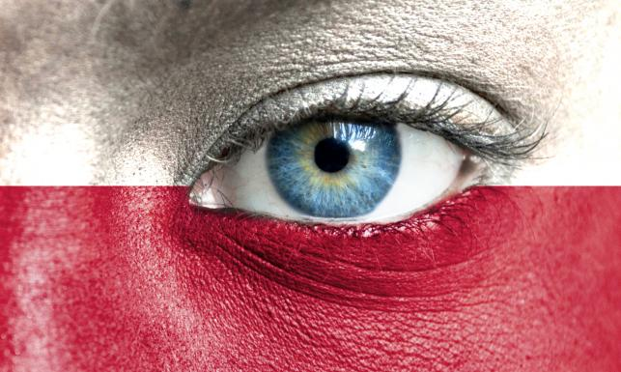

ICT Sector, 2019
IT sector is our export pearl, prof. Adam Glapiński, President of NBP
This year's surplus in the balance of exchange of services with foreign countries will reach a magical value of PLN 100 billion (almost 5% of GDP).
In the year of Poland's accession to the EU, the surplus was PLN 6.2 billion (0.7 per cent of 2004 GDP), which was over 16 times smaller.
Notes:
I would like to show some facts focus on Poland..
IT sector is our export pearl - said the President of the National Bank of Poland (NBP), Adam Glapiński.
In Poland, the ICT sector is one of the fastest-growing sectors of the economy. He is responsible for about 8 per cent of GDP and one-third of employment in the modern business services sector. The value of the ICT market in Poland is estimated at PLN 42.2 billion.
Salaries in the IT sector are more than 2 times higher than the average salary.
We also see an increase in the importance of services in Poland’s economy. The exports of IT services will be more a result of quality competition, not price or wage competition.
Traditionally, Poland is a leader in the transport sector - although in 2010 this sector accounted for almost 100 per cent of the surplus, currently its share has fallen to 30 per cent.
The trade balance in the category "telecommunications, IT and information" has increased impressively - we had a deficit in this category eight years ago. Now, we have a surplus of PLN 8.7 billion, which was mainly due to IT services (up to PLN 8 billion). As a result, we jumped in the European ranking from the third ten to the fifth position.

Slide 3

KADRA PROJECT
RESEARCH AND ANALYSIS
  Digitalisation
  Automation
  Decarbonisation
  Demograghic changes
  Globalisation
TRAININGS FOR UNION Rep.
Notes:
I would like to keep your attention on the effects of our project - Kompetentny związkowiec (The competent trade unionist). In part of the research, the project focused on 5 megatrends, and we are currently conducting training sessions to support trade unionists.
The research included members of social dialogue institutions, employees and trade union activists of the "KADRA" and the Trade Union Forum with:
• Social Dialogue Councils,
• Regional Social Dialogue Councils,
• Labor Market Council,
• Regional Labor Market Councils,
• Poviat Labor Market Councils,
• Monitoring Committees of EU Programmes,
• Tripartite Sector Committees,
• and employees and trade union representatives who may become active participants in social dialogue in the future.

Slide 4
DIGITALISATION AND OTHER MEGATRENDS IN TU ACTIVITIES
Identification of the needs and problems of KADRA REPs.
June, 2018
August, 2018
Preparation of the project and the application
Grant decision
December 2018
April 2019
Project implementation
CAWI (n:211)
FGI (n:100)
GIG research
June & July 2019
October 2019
First Trainings for TU Rep
Notes:
What’s important that Kadra project has prepared using available IT tools in all steps.
We used IT tools to develop surveys, distribute information and questions, as well as to get the answers via REPs smartphone or computer.
We monitor the situation and opinions. It suport the unions e.g. to prepare statements, consultations and other.
We know much more about the impact of digitlisation and megatrends.
We prepare a small platform for debate between colleagues.
CAWI Computer Assisted Web Interview.
FGI Focus Group Interview

Slide 5
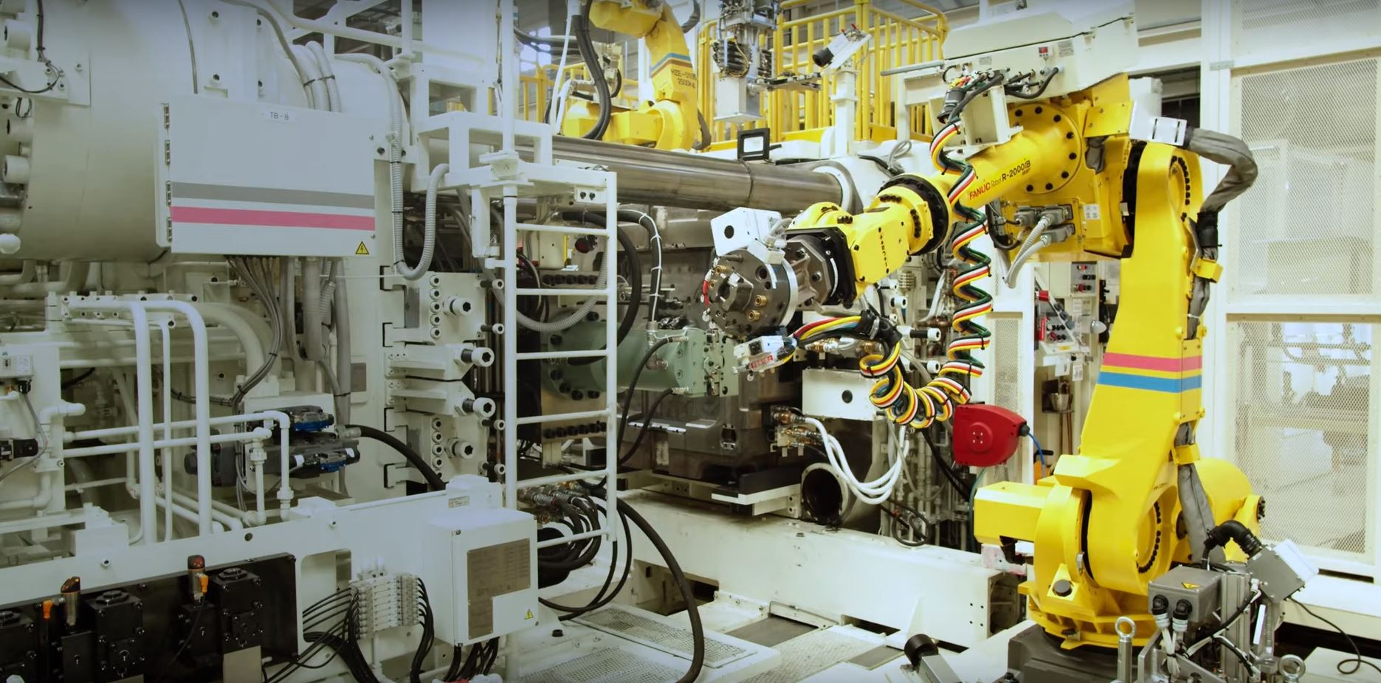
Does the automation of production and other areas of industry an opportunity or a development barrier for the domestic labour market?
opportunity
barrier
I do not know
Photo source: Toyota YT
Notes:
We do the assessment of the impact of the automation of production on the domestic labour market
The impact of automation was the opportunity for 80% of trade unions REPs.
Only for 14% REPs found the barier at the labour market.
6% had no opinion.
Due to the automation of the national economy, trade unions and social dialogue bodies should work to use this process for economic growth in the country and local communities, favouring social inclusion and strengthening the human feeling of the fullness life.

Slide 6

Creation of new, better-paid jobs
Increase of unemployment
In your opinion, will the effect of the automation of industrial processes be an increase in unemployment or the creation of new and better-paid jobs?
Other
Notes:
In the Trade Unions opinions of 59% of trade unionist, the automation will determine the process of positive changes in the labour market, focusing on the creation of new and better-paid jobs.
Only 32% of unionit see the potencial of increasing unemployment, as the effect of automation.

Slide 7
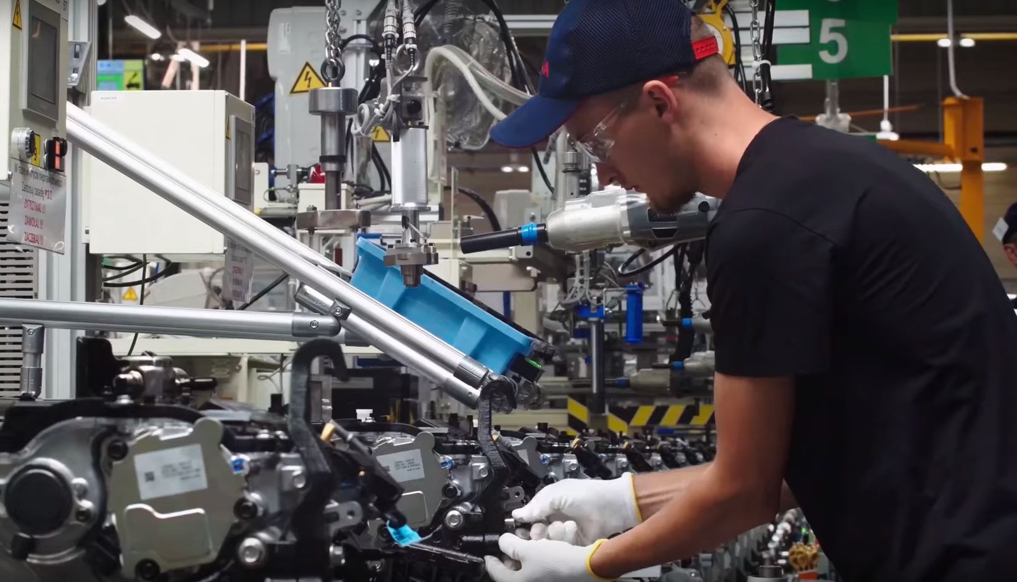
Automation threatens the loss of jobs by highly qualified employees
Does production automation threaten
job losses ?
Automation risks losing jobs only for low-skilled employees whose professional duties are uncomplicated, repetitive and can easily be replaced by intelligent machines
I do not know
Photo source: Toyota YouTube
Notes:
We had the question for the threaten of jobs losses as the effect of automation.
60% of unionist said that automation risk of losing jobs only for low-skilled employees.
34% of unionist said that automation risk of losing jobs concern highly qualified employees, too.
We tried to find also the recommendation due to risk of automation.
The urgent challenge is the inclusion of trade unions and the social dialogue bodies in all work and activities to minimize the fear.

Slide 8
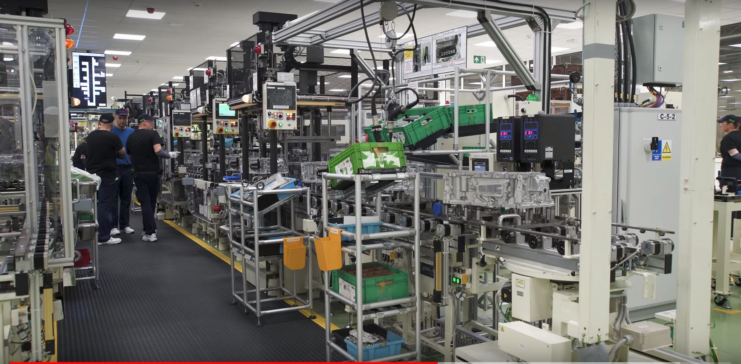
The loss of employment
The occurrence of the allocation process
The impact of automation on the disappearance of employment in some industries and professions
I do not know
Photo source: Toyota YouTube
Notes:
KADRA survey confirms that 62% of unionist consider the occurrence of the allocation process in the workplaces. 31% fears the loss of employment, as the impact of automation.
What accompanies automation is the constant struggle with the processes of marginalization, differentiation and social exclusion. Trade unions must be involved in monitoring and forecasting the effects of automation in the enterprise level.
Trade unionists must be ready to develop proposals and solutions in the area of employees' changing tasks, the roles and professional activities as a result of automation
Trade unions and social dialogue bodies should seriously consider the need to build solutions that protect employees and unique qualifications and competences, which will be replaced by automation.
Trade unions must be involved in building the conditions of transformation caused by automation. Good climate in the workplace, a favourable for employees and their families – it is important for unions.

Slide 9
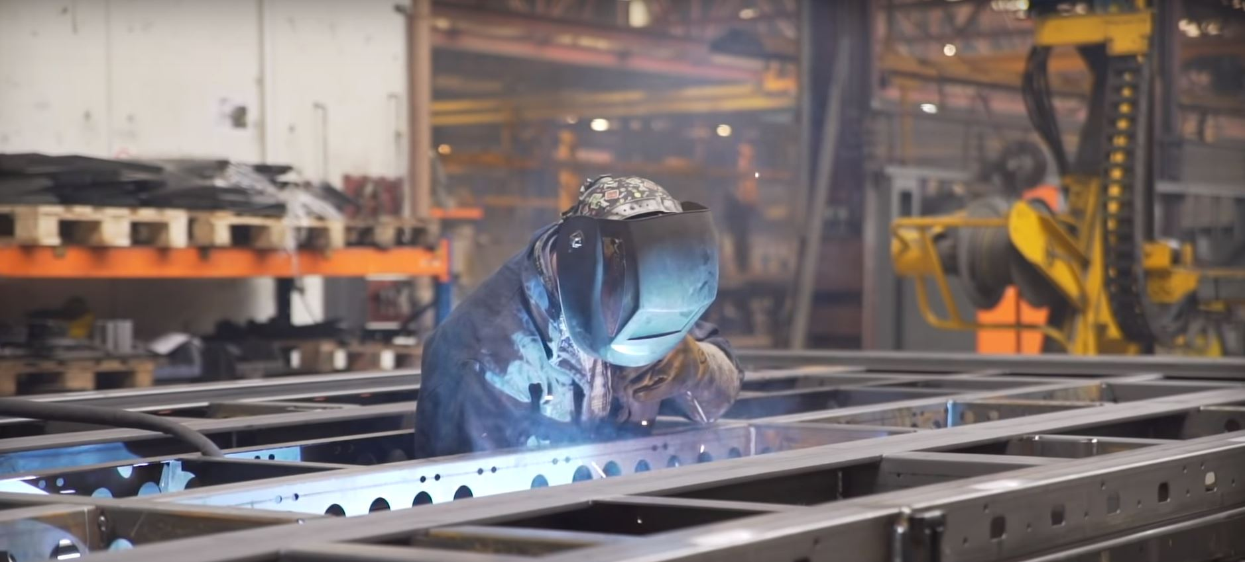
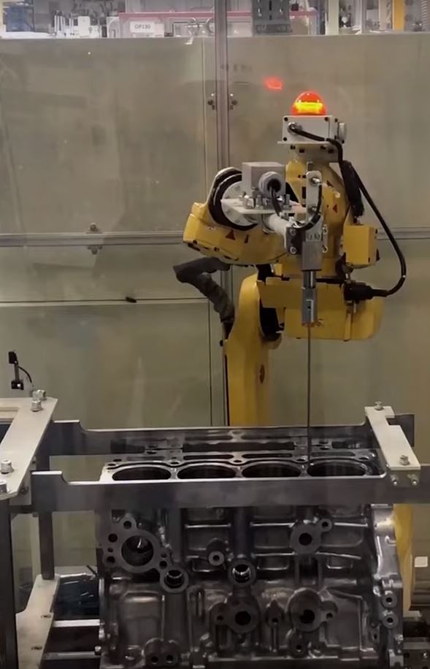
Digital future.
Photo source: Toyota YouTobe
Notes:
Digital future. This the real change. All will be connected and we can't it dump and disconnected for a long time. Now is wired and intelligent. Cars, cities, plants, ports, farms, mines, steelworks and our bodies will be wired with sensors and will tack to each other. It will be like a storm of change, creating also new workplaces and forms of work.
Big data. The internet of things. Artificial intelligence and deep learning which feels robotics.
Anything that cannot be digitized or automated will extremely valuable. Machines are very good simulating but not at being.
Robots and Software do our jobs, but this will allow us to focus that cannot be things automated.

Slide 10
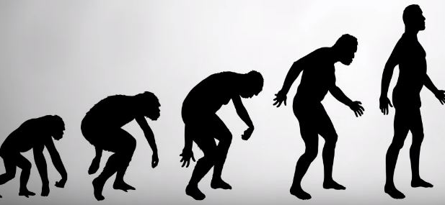
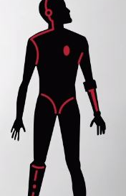

Digital future.
Photo source: YT of Gerd Leonhard, TFAStudios
Notes:
Human evolution has been very slow in the past. Now it speeds up.
We must think of what may be.
The technology gives the answer - HOW.
The human gives the answer - WHY.
So it is important to do to holistic model.
We will buy a lot of new things because of transformative power.
It will create a new way to work and new jobs. It is important for trade unions not only DEFEND workers but also to LEAD.
There is only one space left to innovate - YOU.

Slide 11
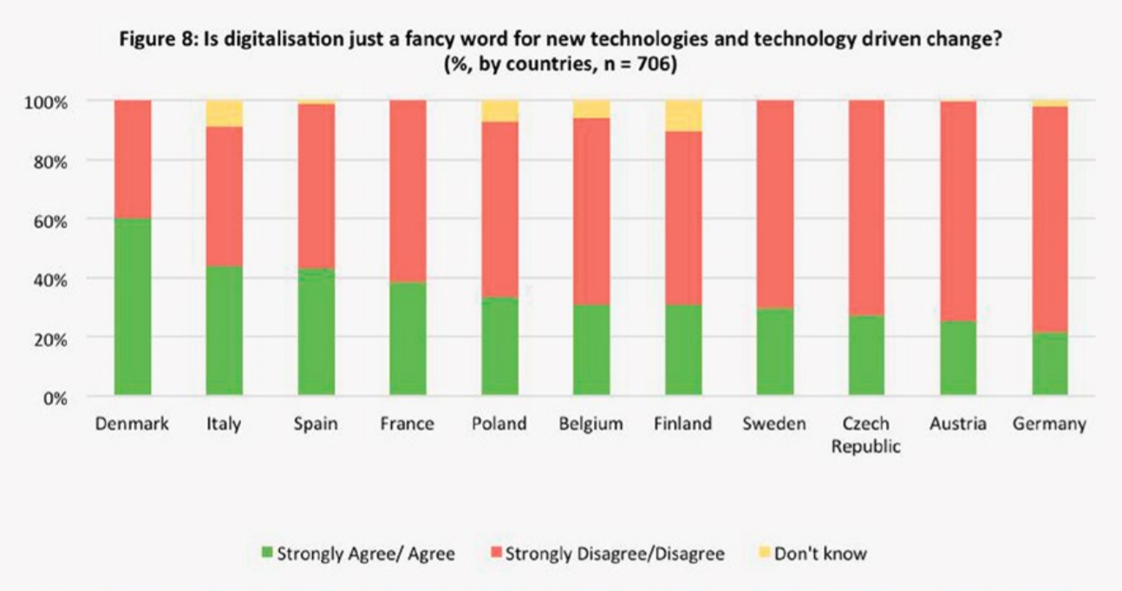

Source: ETUC raport, 08.2018
Notes:
ETUC: A strong majority of survey participants in Germany as well as Austria, the Czech Republic, Sweden, Finland, Belgium and Poland regard digitalisation as more than just a trendy catchword. This was also confirmed by the additional interviews carried out with workers representatives in EWCs and supervisory boards: Interview partners from various countries and across different sectors strongly stressed that digitalisation had been both a source and trigger of restructuring and change programmes, which were more comprehensive and radical than other forms of restructuring.

Slide 12
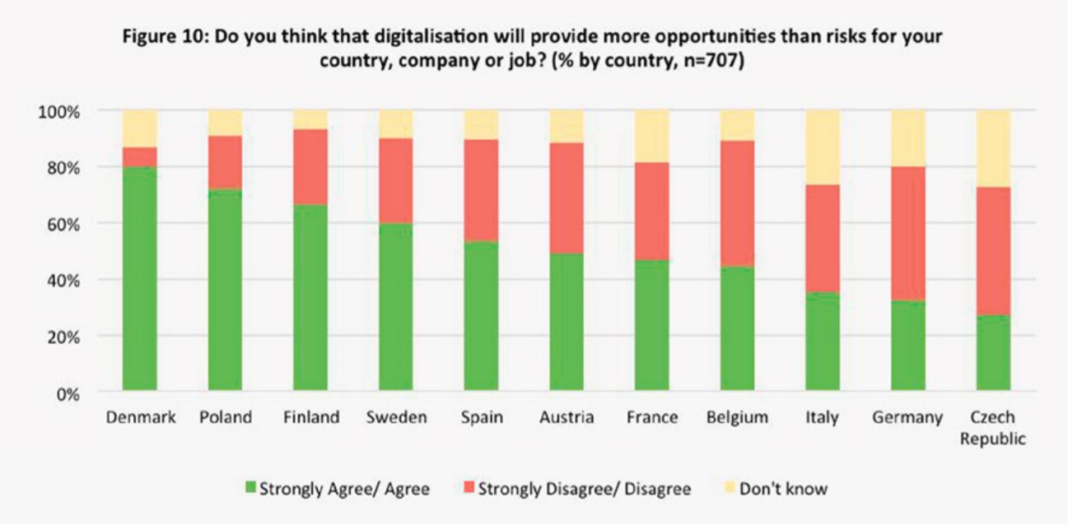
Source: ETUC raport, 08.2018
Notes:
ETUC: The differences between geographic regions become even more striking when looking at individual countries: Whereas in Denmark and Poland respectively 80% and more than 70% of respondents thought that digitalisation was good for their country or company, percentages in Italy (35%), Germany (33%) and the Czech Republic (27%) were much lower. Accordingly, scepticism towards the opportunities afforded by digitalisation to countries and companies varied greatly (cf. Figure 9), ranging from only 7% of respondents in Denmark expecting more risk to 45% in Belgium and the Czech Republic and even 47% in Germany.

Slide 13
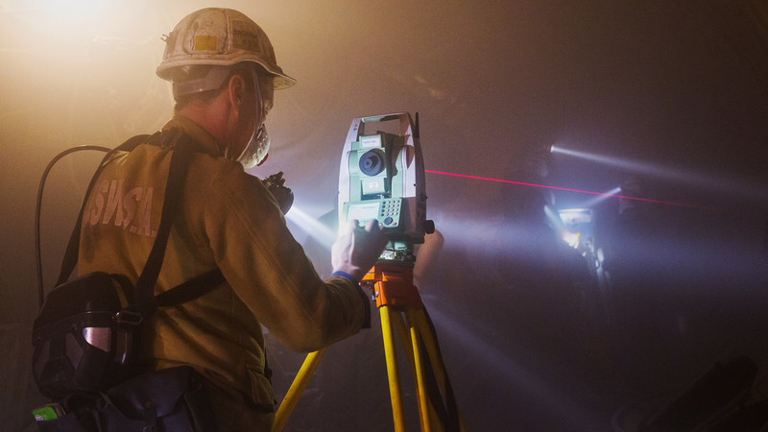
Change of the world as a result of digitalisation in the opinions of the KADRA & FZZ trade union (N: 21)
The intuitive approach to the technological innovation of young people
Potential digital exclusion of older people
The need to keep up with technological changes
Photo source: website https://www.tujastrzebie.pl/
Notes:
We know that the change of the world as a result of digitalisation concern workers, also at the traditional industries.
The photo shows digital 3D modelling of coal deposits and production planning in Poland.
The conclusions of the study:
We've been discussed the conclusion and most of the feedback has been focused on:
The intuitive approach to the technological innovation of young people
Potential digital exclusion of older people
The need to keep up with technological changes

Slide 14
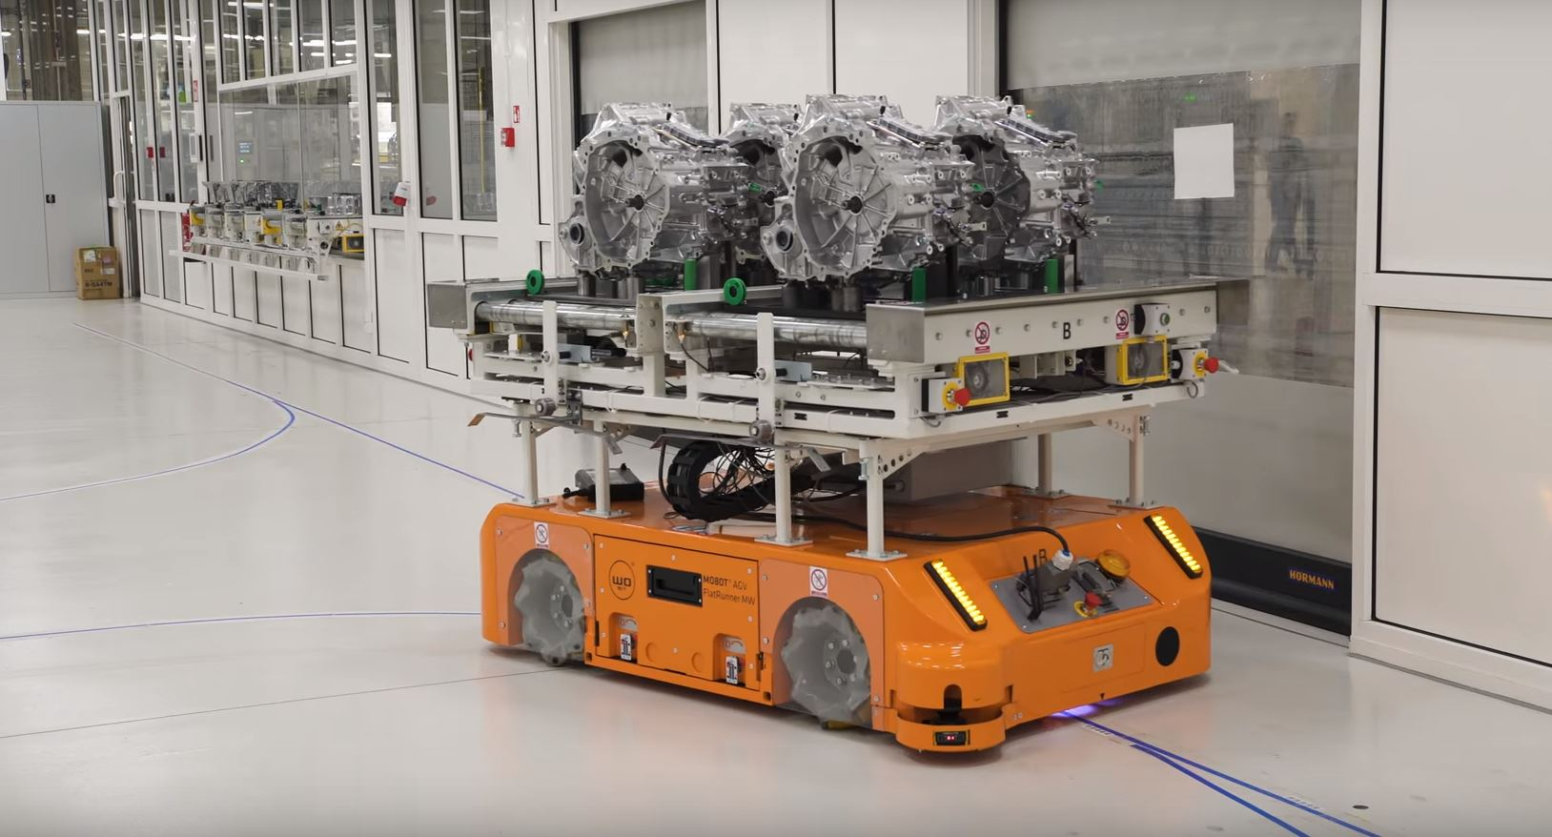
The biggest challenges facing companies wanting to carry out
digital transformation in REPs opinions
Insufficient team digital competence
Insufficient competences of the managerial staff
Insufficient funds allocated
to develop technologies in the company
Other
Photo source: Toyota YouTube
Notes:
We discussed the problem and challenges of digital transformation at the company level. The biggest problem identified concerns „Insufficient funds allocated to develop technologies in the company” (yellow - 42%).

Slide 15
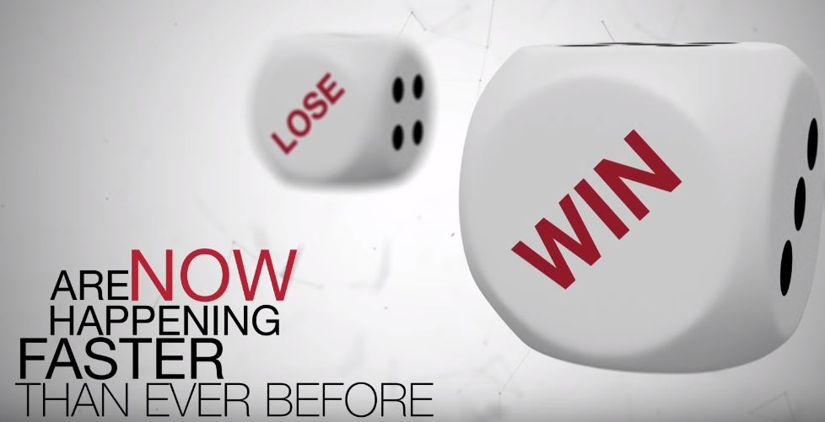
Better paid jobs will be created
The impact of the digitalisation of industrial processes on the competitiveness of the national economy in trade union’s opinions.
Increase in competitiveness
Other
Photo source: YouTube of Gerd Leonhard, TFAStudios
Notes:
The digitalisation of industrial processes in the opinion KADRA and Forum REPs mainly determines the increase in competitiveness of the national economy (64% of responses)
Trade unions will work to use digitalisation for economic growth in the country and in local communities.
Digital transformation is a significant challenge for the labour market and education.

Slide 16
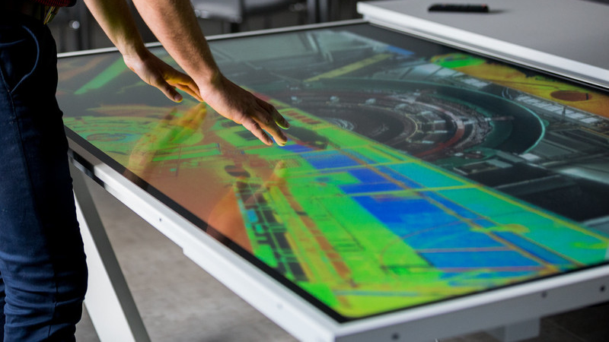
Conclusions and recommendations
NO studies indicating the impact of digitalisation on the Polish labour market
Conduct research in the area of the impact of digitalisation on the labour market.
LIMITATION of financial resources:
to develop the concept of establishing a "transformation fund" enabling companies to obtain grants for research and training in the field of digitalisation and the purchase of new technological solutions.
Photo source: website http://nettg.pl/
Notes:
We have developed some of conclusions and recommendations based on KADRA project.

Slide 17
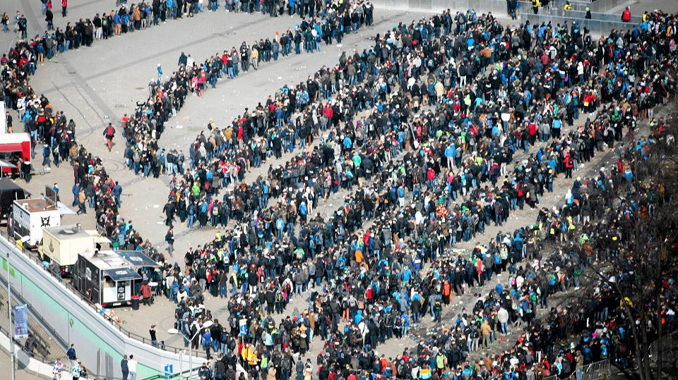
Photo: Young people wait for IEM Katowice, 2019
Conclusions and recommendations
Future prosperity will depend heavily on how well societies and governments cope
with the digital revolution.
The need to develop trainings
for older people so that they are not digitally excluded.
Trade unionists point to the great interest in new technologies in older people.
Dissemination of digital competences among students by introducing new organizational solutions and teaching processes in schools. Modification of the general education core to transfer knowledge and acquire digital skills in the teaching of many subjects.
Allow older people to learn about the use of new technological solutions.
Photo source: Gazeta wyborcza
Notes:
Mainly young people who waited for Intel Extreme Masters in Katowice, Poland, 2019.
You see some of conclusions and recommendations based on KADRA project and research.
What're jobs meet the expectations of hundreds of thousands of local eSports enthusiasts? What are the opportunities and risks for jobs?
These questions will still be valid for a long time.
conclusions and recommendations

Slide 18
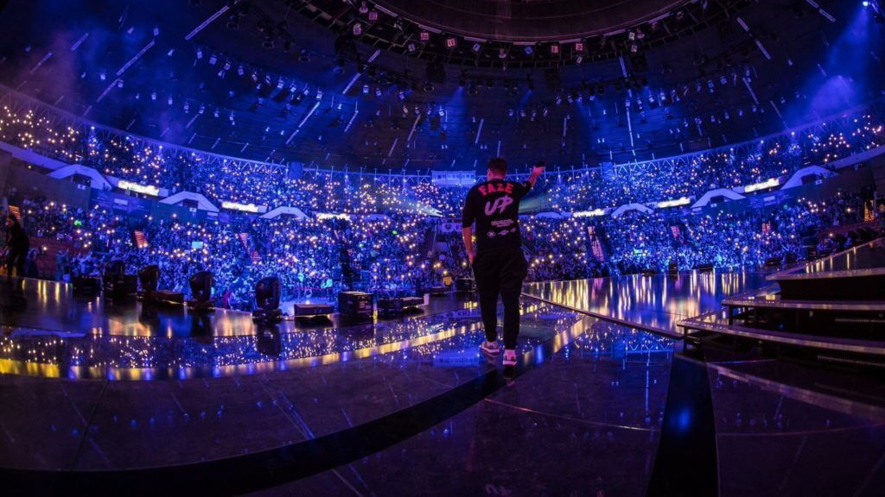
Photo: IEM in Katowice, Poland, 2019
Conclusions and recommendations:
In the era of digitalisation, international cooperation is also important because of cooperation and implementation of economic solutions, exchange of experience.
People struggling with job loss or facing change need comprehensive support based on upgrading qualifications and retraining, including digital competences.
Create an adequate training program both for employees and trade unionists (...)
Introduce to the program for increasing employees and trade unionist digital competences. A shorter training day (4-6 hours) is recommended because such training sessions are more effective. The training plan should also include workshops developing soft skills, i.e. competencies related to self-presentation and communication.
Photo source: EsportRadio24
Notes:
Intel Extreme Masters (IEM) Katowice 2019.
Some of conclusions and recommendations based on KADRA project and research.

Slide 19
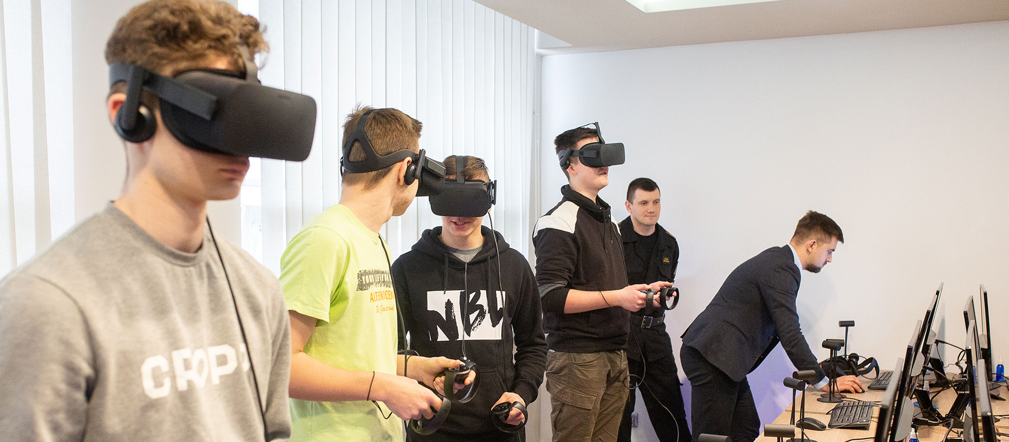
The good practice & best examples:
Virtual Reality Studio and Workers Education
at the workplace, JSW, Poland, 2019.
Young Polish Miners - before they go underground
Students will learn a bit more of mining work.
Photo source: news on the website http://nettg.pl/
Notes:
Digital transformation processes are a serious challenge for the Polish economy, labour market and education. They are also a solution.
On the photos you see – not games, How to use VR applications in the mining sector.
The application engages all the senses and students have new experience all, make decisions, and so they learn and remember.
Most students currently starting primary education will work in new types of professions that do not yet exist.
VR are also usefull for H&S trainings. Unions also must be ready for the changes.
Trade unions were invloved to the social dialogue in Poland and Silesia region. We work with DIGITALISATION in the context of Inteligent Mine in example.
„Intelligent Mine” was one of the strategic projects in the Strategy of Responsible Development, and Plan for Silesia.
It is about the solutions in the field of digitalisation and automation of the planning, mining process with intelligent systems for monitoring threats and health security of employees,
as well as production infrastructure, supervision production process and mine’s management.
Digital knowledge is becoming the foundation of the power of the global economy – that the fact.

Slide 20
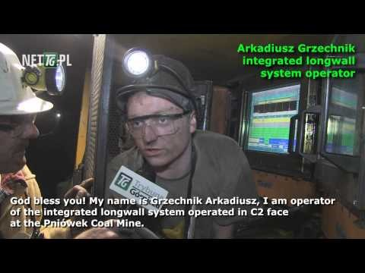
Source: https://youtu.be/rkSTBJ93SCQ
Notes:
YouTube film prepared by the Mining Publisher (nettg.pl) about automation and digitalisation in the coal mining sector.
New technologies reach hardly accessible work.
Technology limits the number of employees in the place of threats to life and health
Source: https://youtu.be/rkSTBJ93SCQ

Slide 21


Thank you for your attention!
Grzegorz TREFON
e-mail: grzegorz.trefon@kadra.org.pl
Bucharest, 4 December 2019
Notes:
Thank you for your attention!

